Slide 1


Sales Dataset Analysis –
Advanced Excel Project
YASHWANTH K
12-12-2024
DA & DS
OCT-24 BATCH

Slide 2

Project Overview & Objectives
Project Objective:
To analyze the given data
Goals:
Analyze sales trends
To Identify high-performing
Determine returns, discounts
Dynamic dashboard

Slide 3
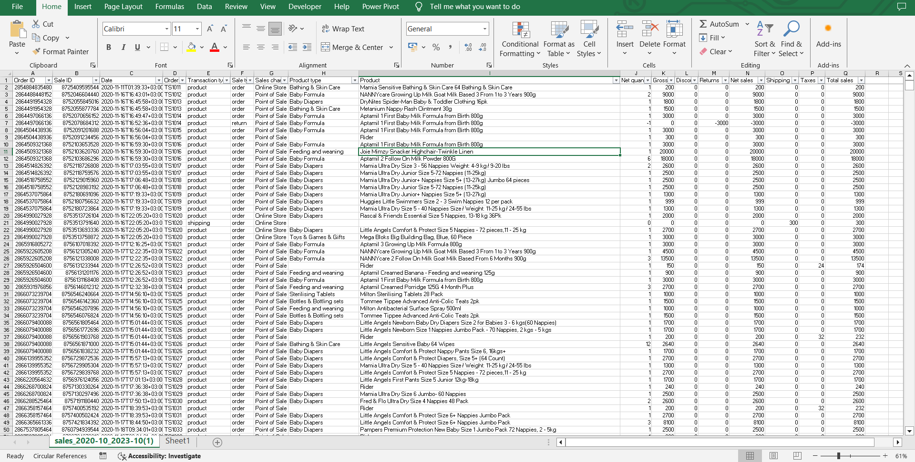
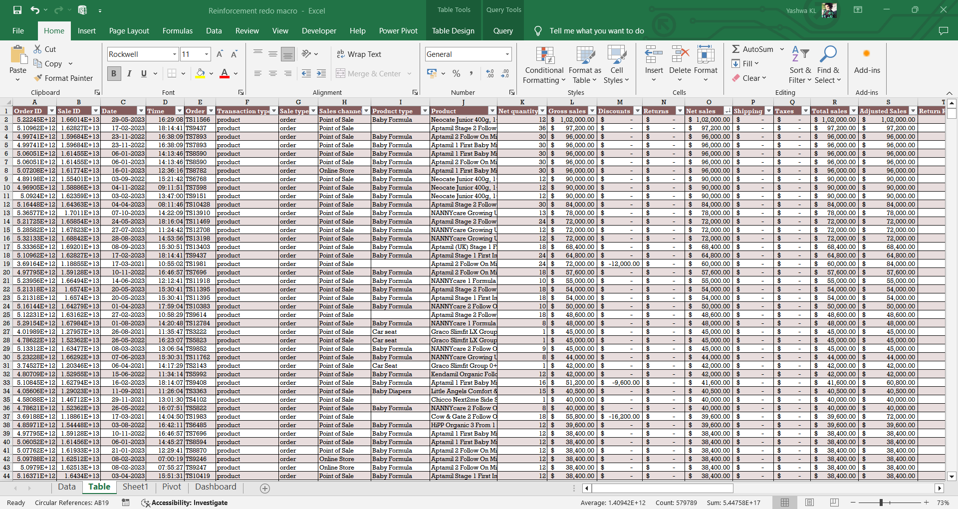
Data Description and Preparation
Dataset Overview:
This Raw Dataset contains (28,756 rows, columns such as Order ID, Sale ID, Product Type, etc.).
Cleaning Process:
Removing Duplicates, Blanks
Missing Values
Data Formatting
Raw Data
Formatted Data

Slide 4

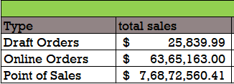
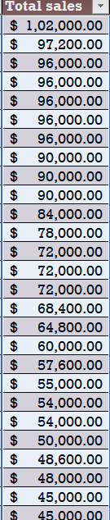

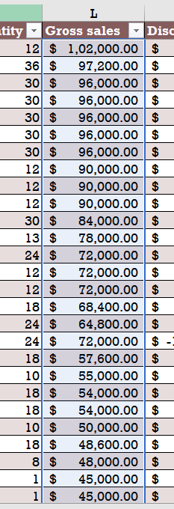


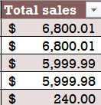
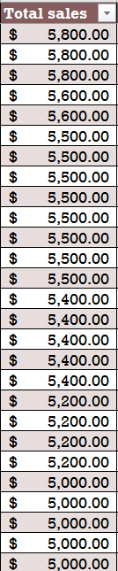
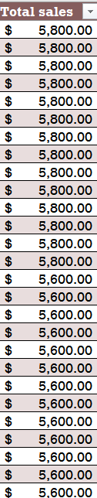
Key Metrics Calculation and Data Analysis
Important Calculations :
Total Sales
Average
Sales by channel

Slide 5
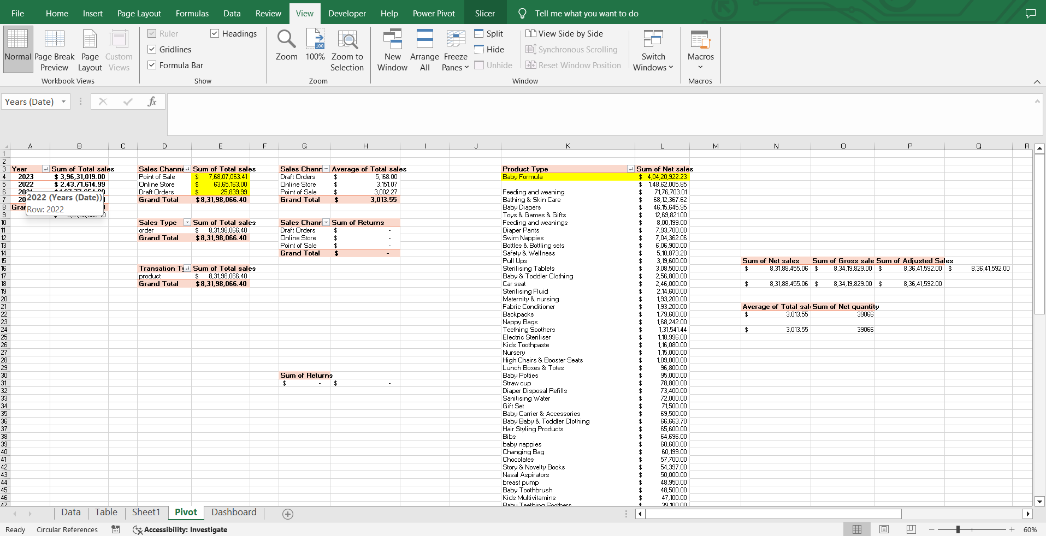
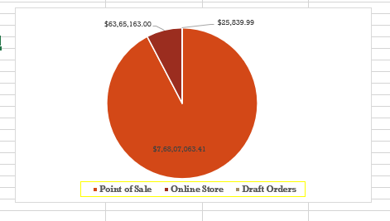
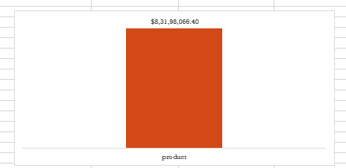
Pivot Tables and Pivot Charts

Slide 6
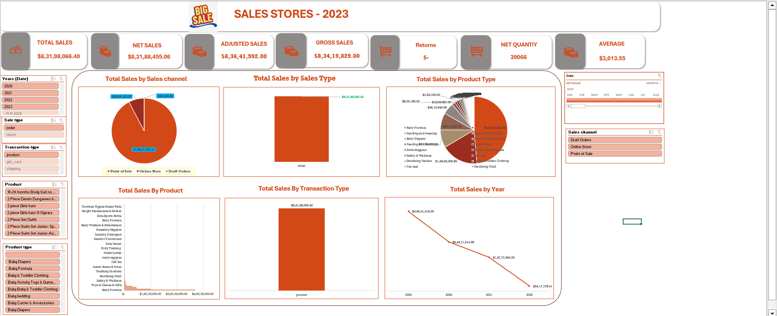
Dashboard Overview
Dashboard Design:
Charts
Slicers
KPI’s

Slide 7
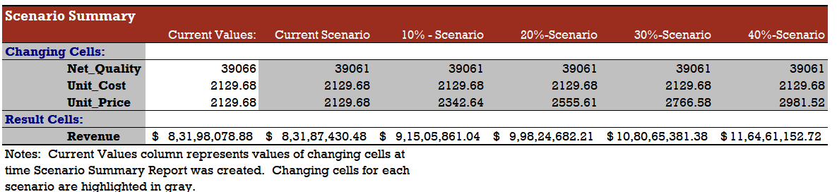
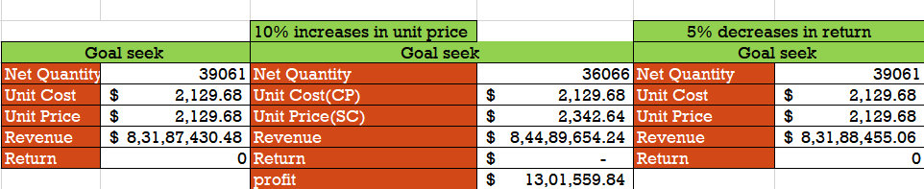
What-If Analysis & Goal Seek
What-If Scenarios:
Goal Seek:

Slide 8
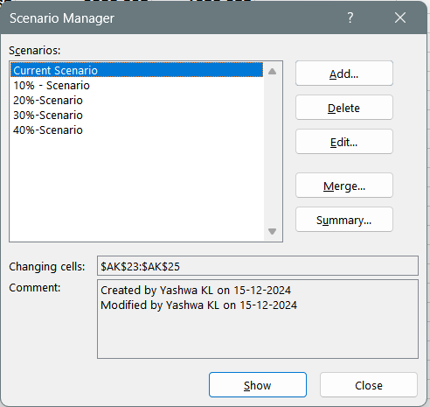
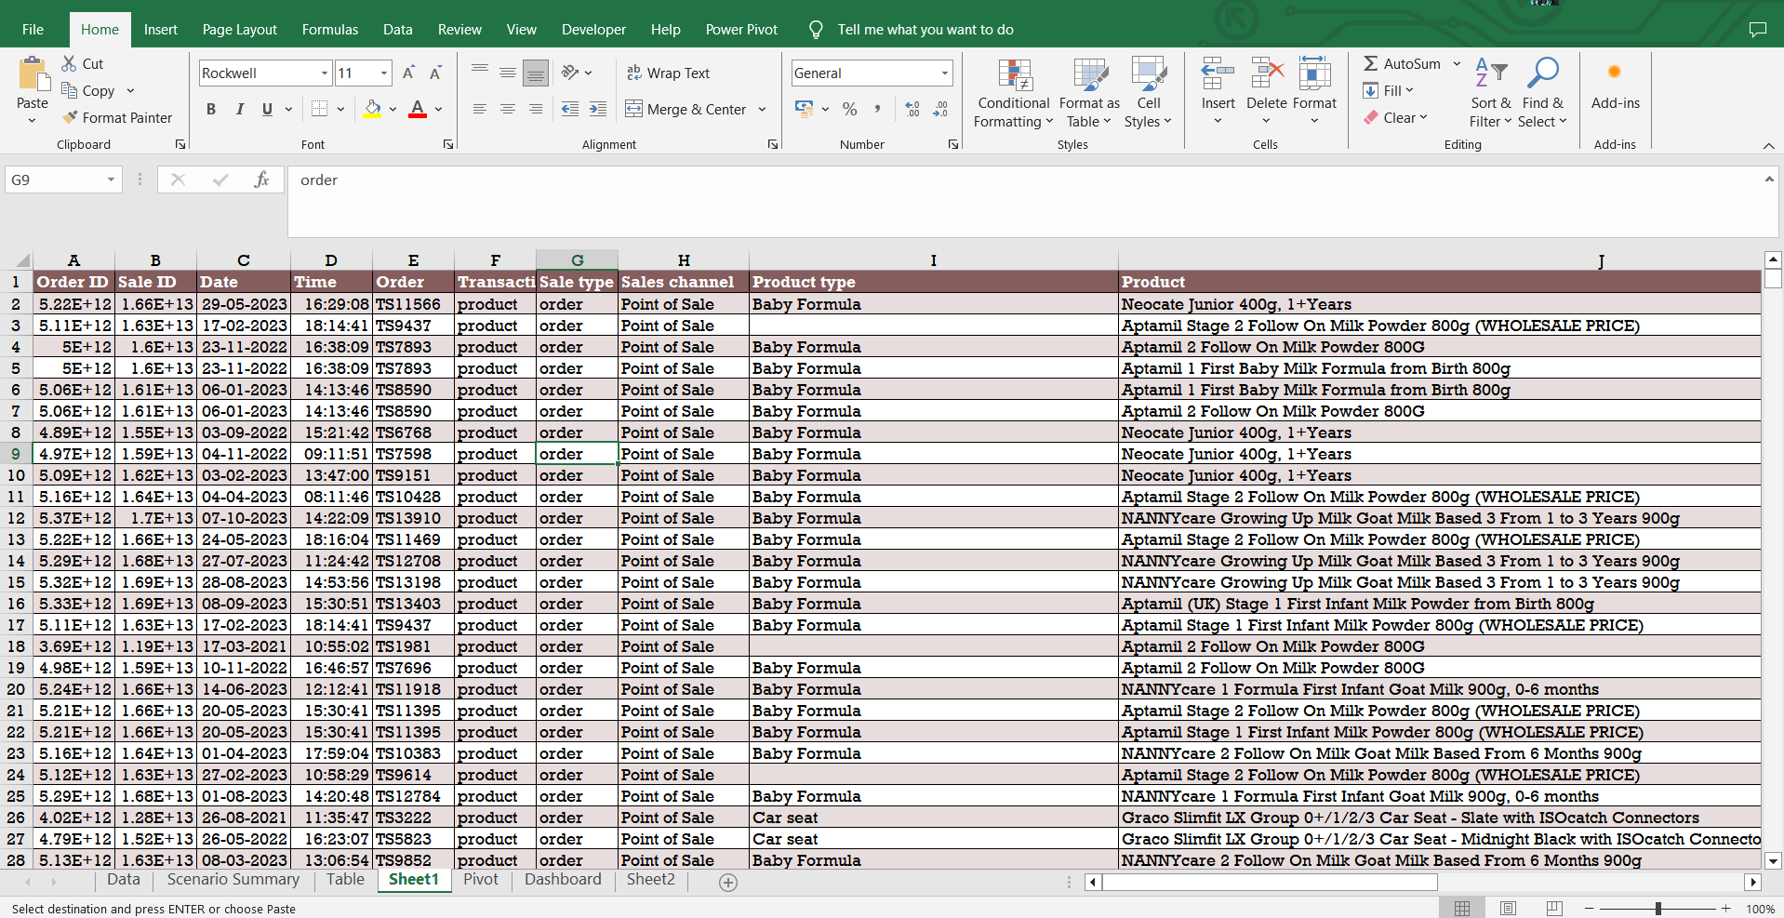
Macros and Automation
Macro Recording:
Macros to automate repetitive tasks.
Automation Benefits:
Macros saves lot of time.

Slide 9
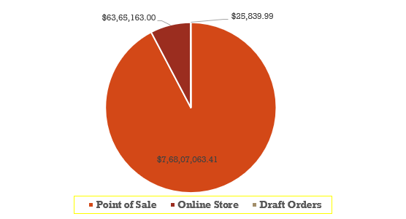
Insights
Best-performing sales channels/products:
Point of Sale – Sales Channel
Trends in discounting and its impact on total sales:
Point of view – Sales Channel
Seasonal sales variations or peak performance times:
2023 – Peak Sales

Slide 10

Conclusion
How to improve the Sales Performance:
Improve the Online orders in Sales Channel by given some offers or discounts.
Improve the baby related products and product type to get more sales.
We need to promote the best selling value products to get more sales in a upcoming futures.
We need to give good products to avoid returns.

